Slide 1

ANALYSIS ON WINE QUALITY DATASET
GROUP - 1
A.Keerthana
B.Esther Rani
N.Sai Prathyusha

Slide 2

CONTENTS
Objective
Dataset
Data Cleaning
Exploratory Data Analysis(EDA)
Classification Algorithms
Regression Algorithms
Conclusion
Insights
Appendix

Slide 3

INTRODUCTION
OBJECTIVE
Develop a model to accurately predict wine quality based on various attributes.
Our focus is on determining the most effective algorithm for predicting wine quality using a comprehensive dataset. By systematically evaluating different Classification and Regression algorithms, we aim to identify the model that delivers the highest accuracy in predicting wine quality.
This analysis holds the key to enhancing the precision of our predictions and, consequently, the overall impact on the wine industry.

Slide 4
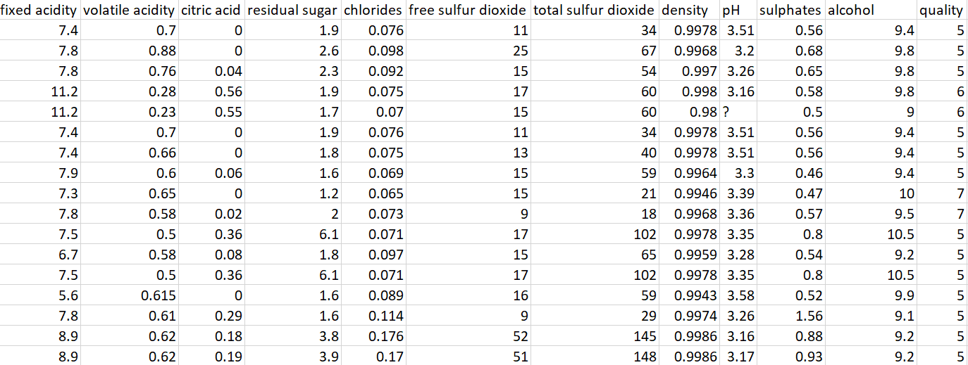
DATASET

Slide 5
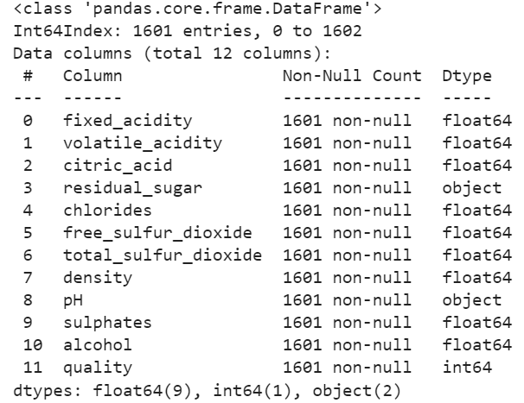
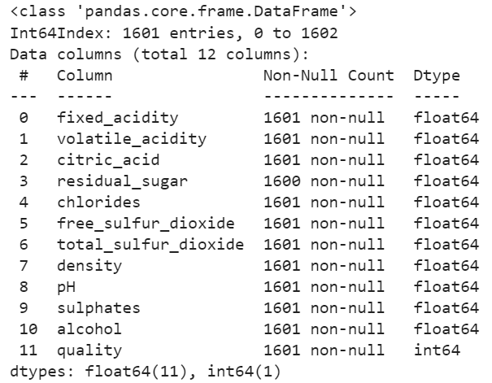

DATA CLEANING
1. Converting object type into float

Slide 6
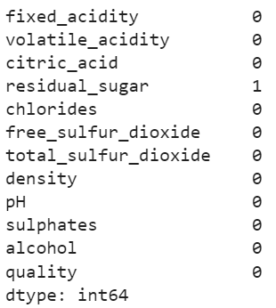
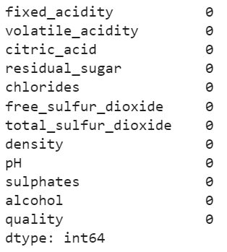
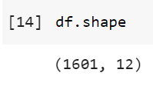
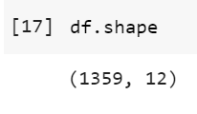
2. Replacing missing values with median
3. Deleting duplicate rows

Slide 7
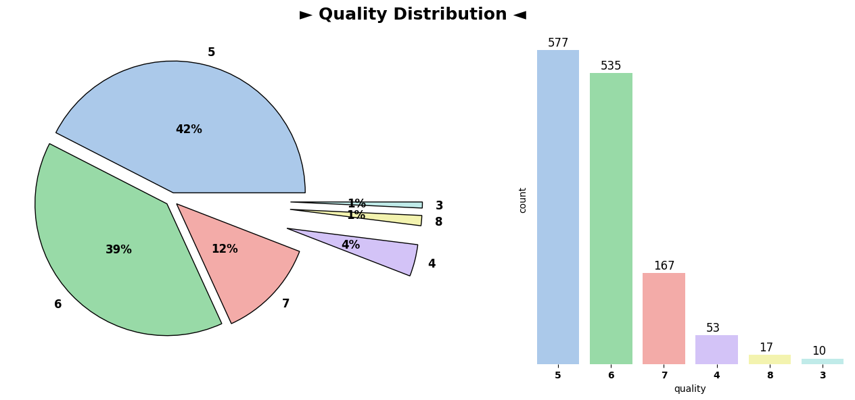
EXPLORATORY DATA ANALYSIS [EDA]
Pie Chart : Quality Distribution

Slide 8
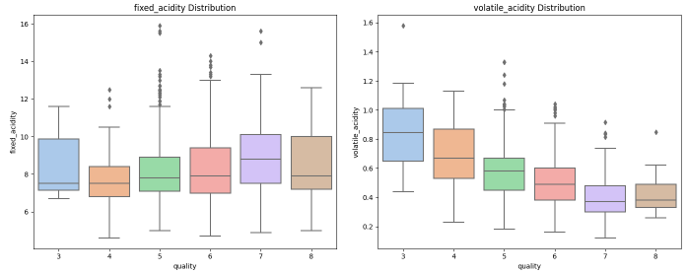
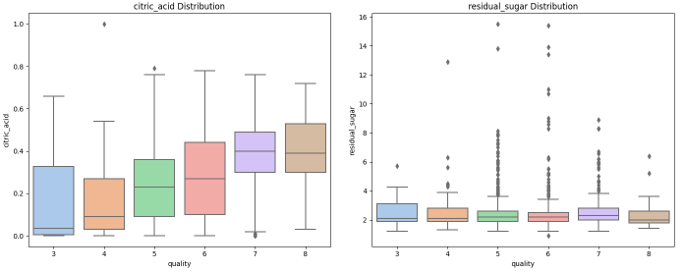
2. Box Plot:
Input parameters
Fixed_acidity Distribution
Volatile_acidity Distribution
Citric_acid Distribution
Residual_sugar Distribution

Slide 9
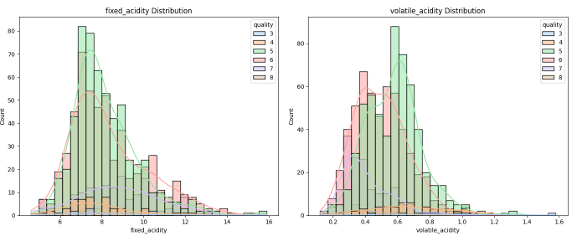
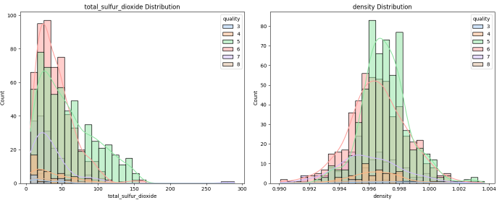
3. Histogram :
Fixed_acidity Distribution
Volatile_acidity Distribution
Total_sulfur_dioxide Distribution
Density Distribution

Slide 10
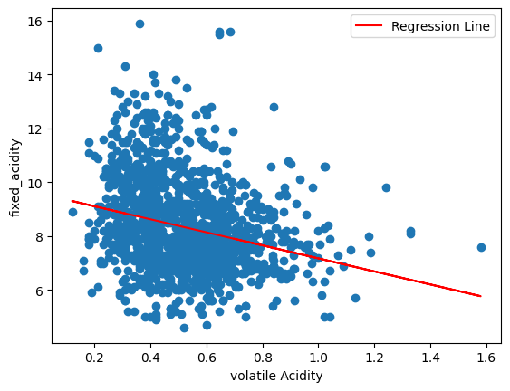
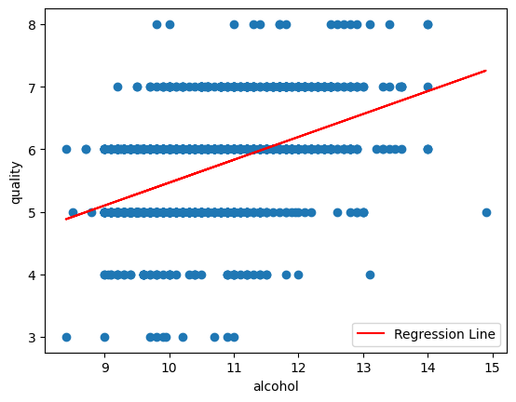
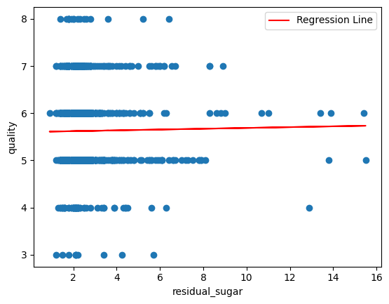
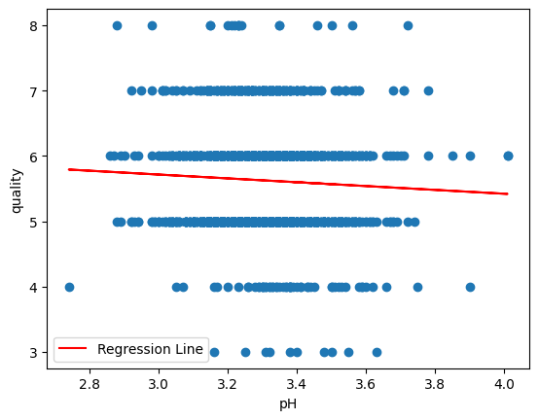
4. Bi-Variate Scatter plot Analysis

Slide 11
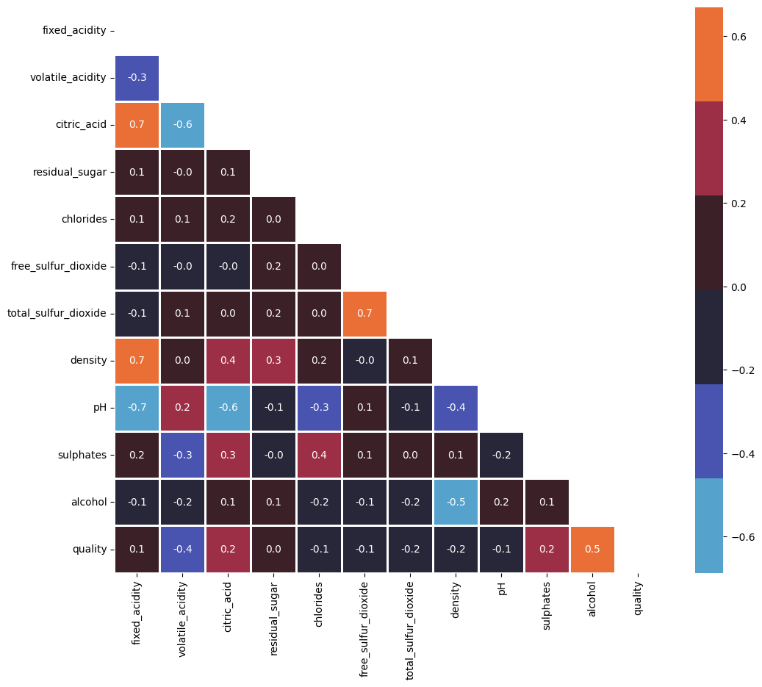
5. Heatmap
(1 vs All)

Slide 12
CLASSIFICATION

Slide 13
Classification Algorithms
Logistic Classification
Random Forest
KNN
Support vector classification[SVC]
Decision Tree
Naive Bayes
Boosting
Neural Network

Slide 14
70:30 ratio
Algorithm |  | Accuracy
Logistic Classification |  | 76%
Random Forest |  | 77%
KNN |  | 69%
SVC |  | 75%
Decision Tree |  | 71%
Naive Bayes |  | 74%
Boosting | Adaptive | 75%
 | Gradient | 78%

Slide 15
75:25 Ratio
Algorithm |  | Accuracy
Logistic Classification |  | 76%
Random Forest |  | 77%
KNN |  | 70%
SVC |  | 76%
Decision Tree |  | 73%
Naive Bayes |  | 74%
Boosting | Adaptive | 74%
 | Gradient | 76%

Slide 16
80:20 Ratio
Algorithm |  | Accuracy
Logistic Classification |  | 74%
Random Forest |  | 74%
KNN |  | 68%
SVC |  | 74%
Decision Tree |  | 71%
Naive Bayes |  | 74%
Boosting | Adaptive | 76%
 | Gradient | 76%

Slide 17
Neural Network
Train Test Ratio | Optimizer | Architecture | Epoch | Accuracy
70-30 | ADAM | 128-64-32-2 | 10 | 76.2%
 | SGD | 128-64-32-2 | 10 | 77.7%
 | RMSprop | 64-32-2 | 30 | 76.4%
75-25 | ADAM | 64-32-2 | 10 | 77.6%
 | SGD | 128-64-32-2 | 50 | 77.9%
 | RMSprop | 64-32-2 | 30 | 78.8%
80-20 | ADAM | 64-32-2 | 10 | 75.3%
 | SGD | 64-32-2 | 30 | 77.9%
 | RMSprop | 64-32-2 | 10 | 76.1%

Slide 18
REGRESSION

Slide 19
Regression Algorithms
Linear Regression
Random Forest
KNN
Support vector Regression[SVR]
Decision Tree
Naive Bayes
Boosting
Neural Network

Slide 20
70:30 Ratio
Algorithm |  | MAPE
Linear Regression |  | 9.36%
Random Forest |  | 9.55%
KNN |  | 9.55%
SVR |  | 13.98%
Decision Tree |  | 13.98%
Naive Bayes |  | 14.54%
Boosting | Adaptive | 14.54%
 | Gradient | 14.54%

Slide 21
75:25 Ratio
Algorithm |  | MAPE
Linear Regression |  | 9.26%
Random Forest |  | 9.28%
KNN |  | 9.28%
SVR |  | 14.12%
Decision Tree |  | 14.12%
Naive Bayes |  | 14.40%
Boosting | Adaptive | 14.40%
 | Gradient | 14.40%

Slide 22
80:20 Ratio
Algorithm |  | MAPE
Linear Regression |  | 9.93%
Random Forest |  | 9.93%
KNN |  | 9.93%
SVR |  | 14.27%
Decision Tree |  | 14.27%
Naive Bayes |  | 14.50%
Boosting | Adaptive | 14.50%
 | Gradient | 14.50%

Slide 23
Neural Network
Train Test Ratio | Optimizer | Architecture | Epoch | MAPE
70-30 | ADAM | 64-32-1 | 30 | 10.53%
 | SGD | 128-64-32-1 | 50 | 9.17%
 | RMSprop | 128-64-32-1 | 10 | 12.46%
75-25 | ADAM | 128-64-32-1 | 30 | 11.73%
 | SGD | 128-64-32-1 | 50 | 9.21%
 | RMSprop | 64-32-1 | 10 | 12.44%
80-20 | ADAM | 64-32-1 | 50 | 11.14%
 | SGD | 128-64-32-1 | 50 | 11.00%
 | RMSprop | 128-64-32-1 | 10 | 11.61%

Slide 24
CONCLUSION
In general, Classification algorithms perform better on this wine quality dataset when compared to Regression algorithms because the R^2 values are always less than 0.5
In Classification, the Gradient Boosting algorithm is giving the highest accuracy i.e 78% for the train test split 70:30 ratio.
In Regression,the Linear Regression algorithm is giving the best results with a minimum MAPE value of 9.26% when compared to other algorithms for the train test split 75:25 ratio.

Slide 25
In Regression algorithms, irrespective of the train test split ratios, the Decision tree algorithm is yielding faulty(negative) R^2 values.
In Neural Network Classification algorithm, the SGD optimizer is giving the best average results similarly, in Regression algorithm, the ADAM optimizer is giving the best average results.

Slide 26
INSIGHTS
Winemaking Optimization:
The wine dataset can be instrumental in optimizing winemaking processes by providing insights into the key attributes that contribute to high-quality wines. Winemakers can adjust variables such as acidity, sweetness, and alcohol content to enhance the overall quality of their products.
Benchmarking and Research:
Comparative Studies: Compare different models or approaches for predicting wine quality. Researchers might use this dataset to test new algorithms or methodologies in predictive modeling.

Slide 27
Quality Control in Production:
The dataset can be employed for rigorous quality control in wine production. By utilizing predictive models, producers can implement real-time monitoring and adjustments, ensuring consistent quality across batches and minimizing the likelihood of undesirable variations in the final product.
Understanding Wine Characteristics:
Exploratory Data Analysis: Explore relationships between different attributes (e.g., acidity, alcohol content, pH) and how they affect the overall quality of wine. This analysis helps in understanding the characteristics that define high-quality wines.

Slide 28
APPENDIX
Classification:-
https://colab.research.google.com/drive/1U1fod9dkaExDuvkrzZ5oTySjI6z86Iqe?usp=sharing
Regression:-
https://colab.research.google.com/drive/19tVe3ZbHWqJXcEUI6BQgW4xGEzLNpasc?usp=sharing
Neural Network(Classification-80/20):-
https://colab.research.google.com/drive/1hmHwFL52_h_5BXS83-wTSkTCyKCScNic?usp=sharing
Neural Network(Regression-80/20):-
https://colab.research.google.com/drive/1pn6TpXmCfKeXDirh8te6aC3DVC97B609?usp=sharing

Slide 29

Thank You!

